Slide 1
Transplant Rejection
Dr.Manoj Radhakrishnan
Dept. of Pathology, SKHMC

Slide 2
Kinds of grafts or transplants
Allograft: graft between genetically different individuals.
autograft: graft of one’s own tissues
Isograft: graft from identical twin

Slide 3
Types of transplant rejection
Hyperacute transplant rejection
Acute transplant rejection
Chronic transplant rejection

Slide 4
Hyperacute transplant rejection
Occurs within minutes of transplantation
Mediated by preformed antidonor antibodies,present in recipient’s circulation.(ABO incompatibilty)
Antigens in the endothelium of the transplanted organ are recognized by the preformed antibodies(IgM & IgG) Capable of complement activation-fibrinoid necrosis-ischemic necrosis of organ.

Slide 6
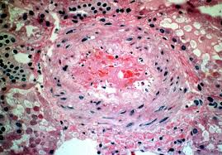
Hyperacute rejection

Slide 7
Acute transplant rejection
Occurs within days or months after the transplantation
Mediated by both humoral(antibody mediated) and cellular (T-cell ) mediated mechanisms
Vasculitis is a prominent feature, it is mediated by antidonor- antibodies -attack vessel wall,with subsequent thrombosis and thickening of the arterioles-vascular changes cause an ischemia of transplanted organ.
Interstitial accumulation of lymphocytes is a prominent feature-associated with parenchymal cell injury.

Slide 8
Acute transplant rejection

Slide 9
Chronic transplant rejection
Caused predominantly by vascular changes(intimal fibrosis)accompanied by ischemia and loss of parenchymal cells.
Gradual and progressive decline in transplanted organ over a period of months and years

